Slide 1
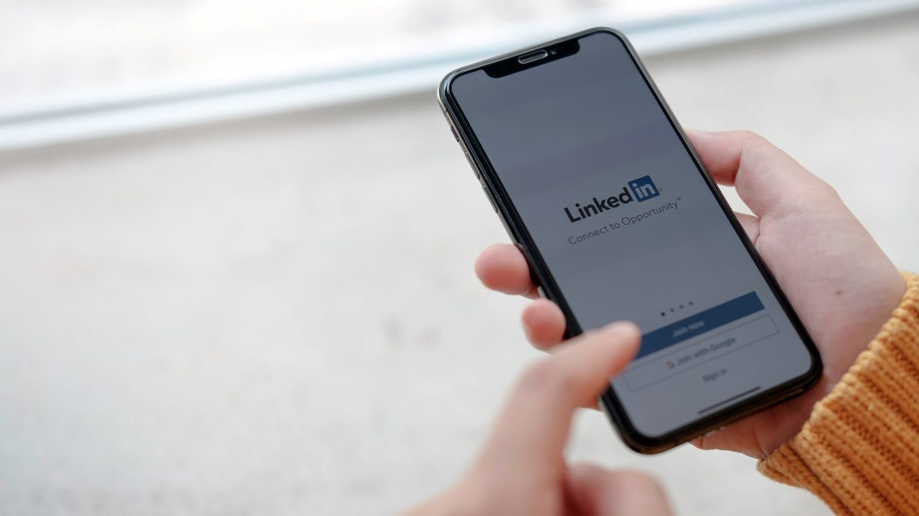
CFPB Data Analysis
Sarthak Arora
Feb 2024

Slide 2
Transforming Complaints into Insights using NLP Sentiment Analysis
Data Loading
& Cleaning
Company Response
/ Consent to Customers
Sentiment
Analysis via
NLP
Key Insights & Conclusion
Out of total 4.7M records, around 402K records are obtained by applying filters to three crucial columns related to company’s response and the dispute status
Key statistics and interim insights on company’s response to customers and the consent provided to the customers are observed
Two major NLP methodologies are used: TextBlob and Vader sentiment score, with values ranging from -1 to 1, where -1 means negative and 1 means positive sentiment
Insights on which company’s and state’s performance on complaints resolution with top issues noticed through the analysis

Slide 3
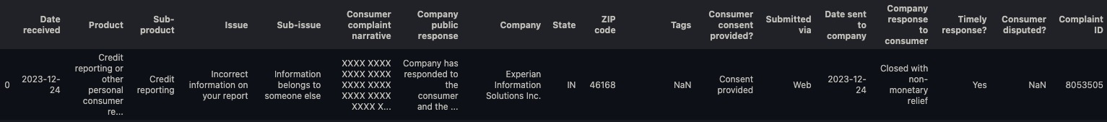
4,750,727
Data Loading Summary
21
7119
3%
# of Records
Unique Products
Unique Companies
Consumers Contested Complaint Resolutions
13 Years
86
89%
69%
Entries Ranging from 2011 to 2024
Unique Sub Products
Complaints via Web
Complaints Closed with Explanation
Sample Data Record

Slide 4
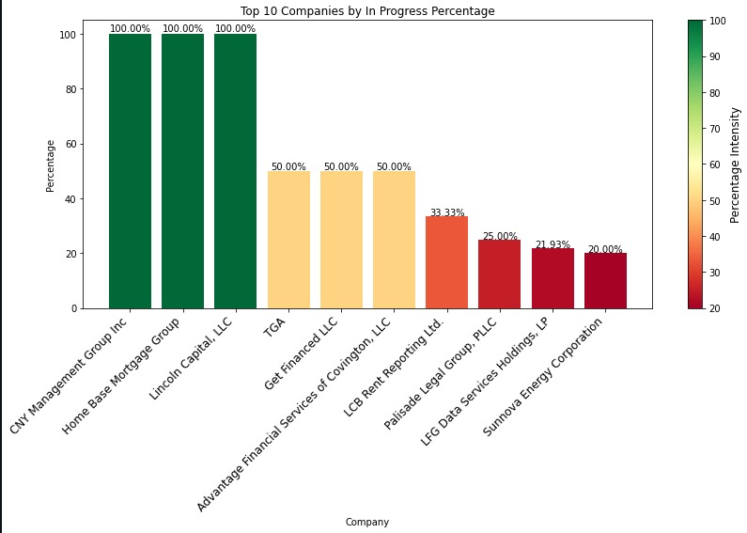
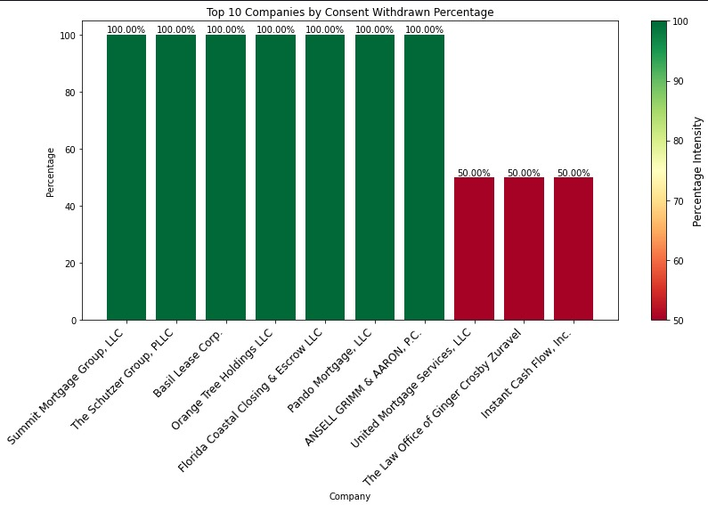
Companies Response/Consent to Customers
Key Takeaway: Top 3 companies with 100% unresolved complaints
Key Takeaway: Top 7 companies where consumers have withdrawn all consent

Slide 5
Conditions Applied for Data Cleaning
Company Public Response
Company Response to Consumer
Disputed?
Can’t verify or dispute facts in complaints
Chose not to provide a public response
Complaint is the result of isolated errors
Complaint represents an opportunity for improvement to better serve customers
Complaint provided an opportunity to answer consumer questions
In Progress
Untimely Response
Yes
Key Enablers of Conditions Applied
Our refined complaint analysis strategy zeroes in on critical areas for improvement by focusing on complaints that are unverified, lack a company response, have untimely replies, or are disputed by consumers. This approach is designed to swiftly identify and address the most pressing issues that could impact customer trust and our company's reputation. It is a proactive step to enhance customer satisfaction and maintain high service standards

Slide 6

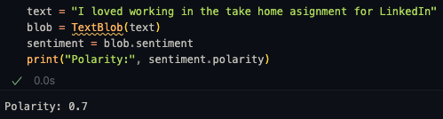


NLP Techniques Used
Vader
Designed to process textual data, helping us understand emotions (positive, negative, neutral) within consumer feedback. It assigns sentiment scores, indicating
positivity (0 to 1),
negativity (-1 to 0), or
neutrality (0)
Tailored for social media analysis, as it assigns sentiment scores with sensitivity to slang, emojis, and intensifiers, revealing the subtle tones of customer interactions. It also assigns sentiment scores, indicating :
positivity (0 to 1),
negativity (-1 to 0), or
neutrality (0)

Slide 7
NLP Sentiment Analysis Insights
Standout/Weakest Performers
Worst Companies
Top Companies
Issue
Coldwater Mediation Group; Money Service Centers of Hawaii; Rabobank, National Association
Advantage One Credit; Imc Capital; Money Tree Lending
Sub
Issue
Bank Of Hawaii Corporation; Catalyst Lending; Grace Period, Inc
Acranet; Earnest; Gabriel Financial Group
Consumer
Complaints
Account Liquidation Services; Harbor Front Acquisitions(Closed);Partridge Snow & Hahn
Brightwater Capital; Credit Bureau of Northern California Collections Services, Loanleaders of America
Top and Worst Performing Companies were identified using the intersection of TextBlob and VADER output, i.e., companies that are common in both the outputs.
NOTE: Most of the worst performing companies have scored between -1 and 0 while top performing companies have scored between 0 and 1
Coldwater Mediation Group LLP
Money Service Centers of Hawaii’
The Money Company
Coldwater Mediation Group LLP
Money Service Centers of Hawaii’
The Money Company

Slide 8
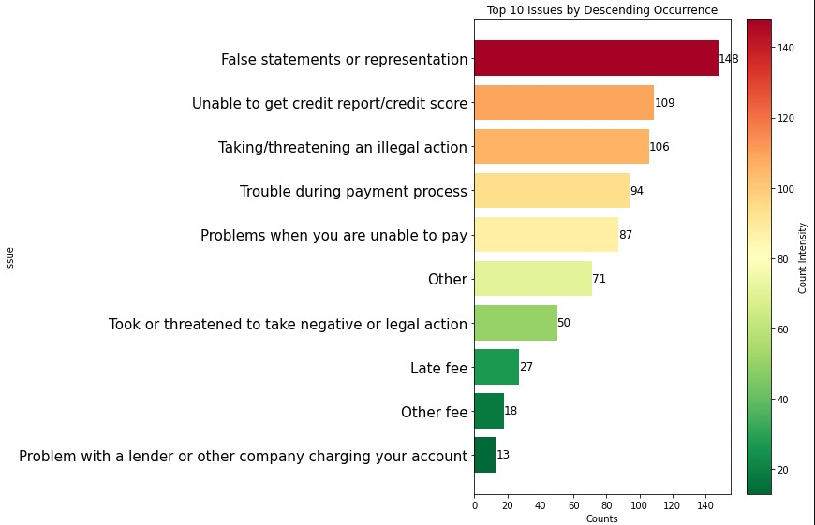
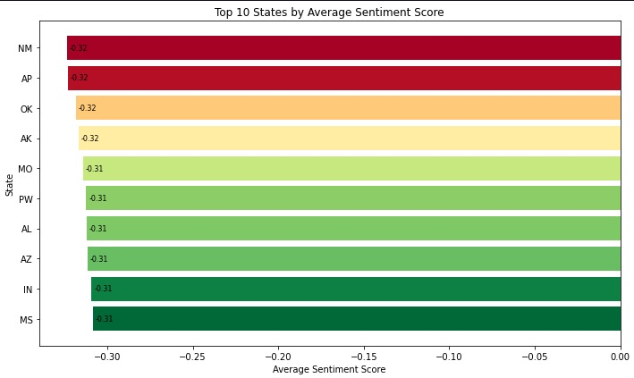
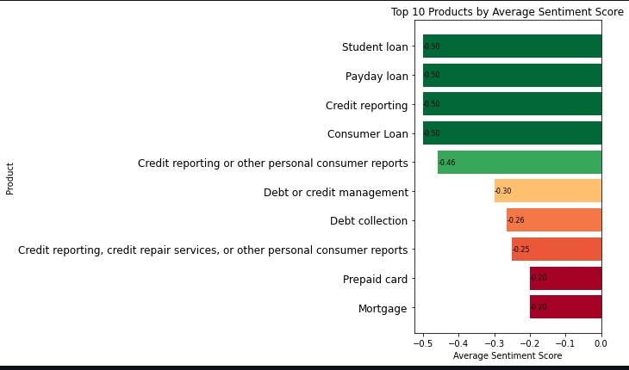
Companies Response/Consent to Customers

Slide 9
Conclusion and Insights
Consumer Sentiment
Minnesota, Armed Forces Pacific, Oklahoma, Arkansas, and Missouri were identified as the top five regions exhibiting the highest levels of consumer dissatisfaction
Product Specific Concerns
Negative sentiment is particularly pronounced in the context of loan-related products, with most grievances associated with Student Loans, Payday Loans, and Consumer Loans
Key Highlights
Money Service Centers of Hawaii and Bank Of Hawaii Corp have received considerable negative feedback from customers, a sentiment which has been consistently captured by NLP models.
In contrast, lending institutions such as Loanleaders of America and Money Tree Lending, while also subject to consumer complaints, have predominantly been perceived positively according to sentiment analysis data
Predominant Issues
‘False Statements or Representations’ was the most reported issue followed by ‘Difficulties in accessing credit reports/scores & incidents involving threats or illegal actions by service providers’
Top Performers
CNY Management Group, a home-based mortgage group, and Lincoln Capital LLC are among the top three firms with 100% rate of unresolved complaints, which are currently being addressed

Slide 10

Thank You!
For questions, please reach out to:
Sarthak Arora
sarthakarora1@outlook.com
Portfolio

